Slide 1
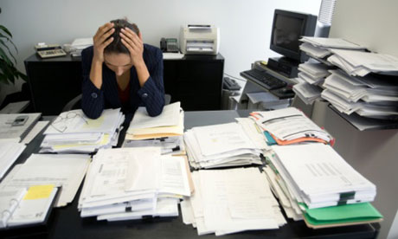
Organizational change and stress management

Slide 2
Why change is so important?
Only organisations that are able to change survive
CHANGE OR PERISH

Slide 3
Forces for change
Changing nature of the workforce
Changing technology
Economic shocks
Competition
Changing social trends
World politics

Slide 4

Changing nature of the workforce
Employees differ in their nationalities, gender, age, education, race, talent, ethnicity, sexual orientation, lifestyle and values

Slide 5

Changing technology
Rapid change
Most modern technology gets outdated in no time

Slide 6

Economic shocks
Economic meltdown and financial crisis has lead to the bankruptcy of many organisations

Slide 7

Competition
Now it is global competition- competition across borders
Only continuous innovation can ensure survival

Slide 8

Changing social trends
Consumers and employees are more demanding
Consumers are able to give the feedback through blogs and chat rooms.

Slide 9

World politics
Changes in government can pose new challenges

Slide 10
Organizational stress
Stress is an inevitable part of modern day life
Organizational stress is a major concern as it can have damaging physiological and psychological effects on people working there.

Slide 11

What is stress?
An unpleasant psychological process that occurs in response to environmental pressures

Slide 12
Stress facts
Is not always negative
Challenge versus hindrance stressors
Commitment and stress
Demands and resources

Slide 13
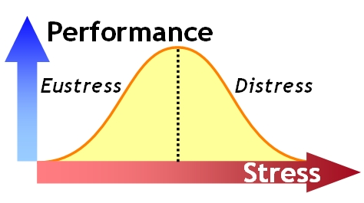
Stress is not always negative
Stress improves performance

Slide 14
Challenge versus hindrance stressors
Pressure to complete work on time or extra work load (challenge stressors)
Stressors that prevent a person from reaching the goal (hindrance stressors)
Hindrance stressors more harmful than challenge stressors
Hindrance stressor >challenge stressor

Slide 15

Commitment and stress
Employees with high levels of affective commitment (positive feelings) tend to improve their performance with stress

Slide 16
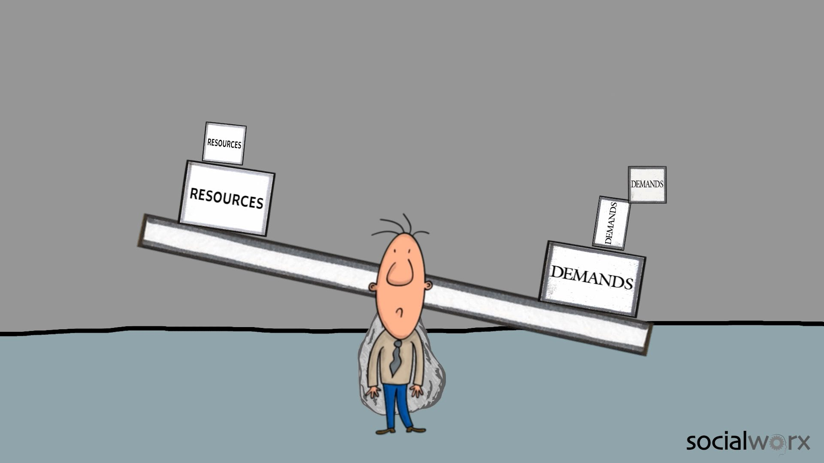
Demands and resources
Stress= demands>resources
Demands- duties, obligations, pressures, expectations or uncertainties
Resources- things that are under an individual’s control

Slide 17
Sources/causes of stress
3 sources
Environmental stressors
Organizational stressors
Personal stressors

Slide 18
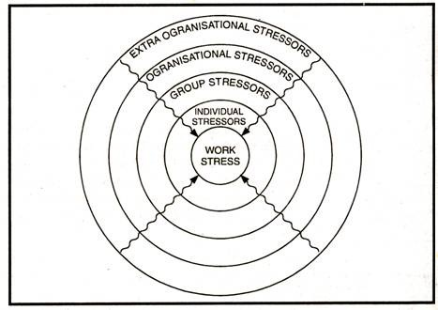

Slide 19
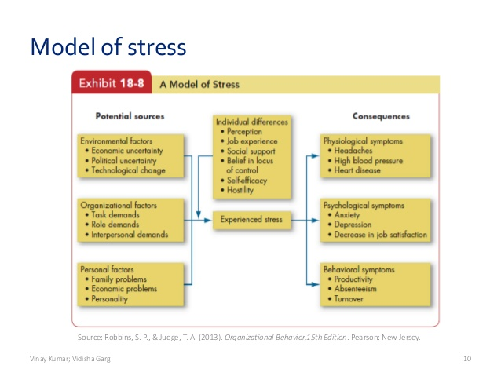

Slide 20
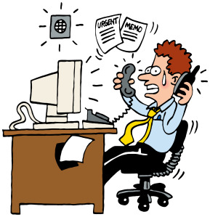
Environmental stressors
Economic uncertainty
Political uncertainty
Technological uncertainty

Slide 21
Economic uncertainty- bad economy causes stress
Political uncertainty- less stress when the political climate is stable
Technological uncertainty- rapid advances in technology pose a threat

Slide 22

Organizational stressors
1) Task demands
2) Role demands
Role conflict
Role overload
Role ambiguity
3) Interpersonal demands

Slide 23
Task demands- level of autonomy, degree of task variety, working conditions, assembly line pressures, overcrowded working conditions, poor lighting , noise, demanding customer service etc.
Interpersonal demands- no cordial relationship with coworkers, superiors and subordinates. Bullying, sexual harassment, physical fights, racial discrimination

Slide 24
Role demands- every employee has a particular role to play. Role demands that cause stress are
Role conflict- arises when different people have different expectations
Role overload- occurs when individuals are asked to do more
Role ambiguity- no clarity regarding work, duties and responsibilities.

Slide 25

Personal stressors
Family problems
Financial problems
personality

Slide 26
Family problems- quarrel between husband and wife or illness in family. Strained relationship between spouses, physically/mentally disabled children
Financial problems- accommodation and standard of living high. Dual career couple- less time for family. Poor money management.
Personality- some are more prone to stress

Slide 27

Individual and cultural differences in the experience of stress

Slide 28
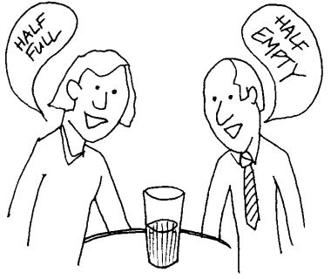
Individual differences
1) Perception- how an employee looks at a situation
How an employee interprets the situation will decide whether he will experience stress.

Slide 29

2) job experience- negative relationship between job experience and job stress. Two reasons
Selective withdrawal- higher stress more chances for quitting work
Coping mechanism- people develop coping mechanisms when exposed to stress for a long time

Slide 30

3) social support- support from coworkers can ease stress

Slide 31

4) personality- high on neuroticism stress more.
Workaholic employees experience more stress
They are obsessed with work
Put in long hours at work
Continuously think about work
Take more responsibility

Slide 32
Cultural differences
Country | Cause of stress
United states | No adequate control over their jobs
China | Job evaluation and lack of training
US, UK, Canada (individualistic cultures) | More stress when work interferes family life
Collectivistic cultures doing additional work is seen as a sacrifice for the family. No difference in the experience of stress across cultures due to personality traits

Slide 33
Effects of stress
Physiological effects
Psychological effects
Behavioral effects

Slide 34
Physiological effects
Upper respiratory illnesses
Poor functioning of the immune system
Heart diseases
Hypertension
High cholesterol
Ulcers
Arthritis
Frequent colds, fever

Slide 35
Psychological effects
Job dissatisfaction
Anxiety
Tension
Boredom
Depression
Irritability
Laziness
Lower emotional well being
Frequent mood changes
Loss of self esteem
Inability to concentrate on work
Inability to make decisions

Slide 36
Psychological effects are more on jobs where
employee’s work lack clarity
Little autonomy
Little job variety
Lack of feedback
Lack of sense of identity

Slide 37
Behavioral effects
Reduced productivity
Absenteeism
Employee turnover
Changes in eating habits
Sleep disorders
Excessive drinking
Drug addiction
Excessive smoking
Poor interpersonal relations
Stammering

Slide 38
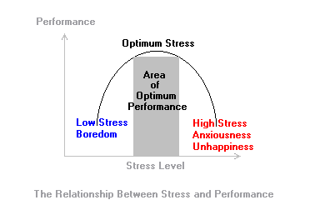
Relationship between stress and performance

Slide 39
Coping with stress
Stress can have positive and negative effects
Management of stress can be done at individual and organizational level

Slide 40
Individual approaches to stress management
Better time management
Physical exercises
Relaxation training
Expanding social support networks

Slide 41

1) Better time management
Prepare a list of activities to be completed
Prioritizing activities
Scheduling activities based on priority
Awareness of one’s daily schedule and doing the most demanding activities when one is most alert
Avoid distraction such as chatting or browsing

Slide 42

2) Physical exercises
Aerobics, swimming, jogging, cycling

Slide 43

3) Relaxation training
Meditation
Hypnosis
Deep breathing

Slide 44

4) Expanding social support networks
Social support from friends, family and co-workers
Close friends are extremely helpful

Slide 45
Other individual measures
Taking a break from work
Telling the superior that one is stressed
Detaching oneself mentally from work when physically away from work

Slide 46
Organizational approaches to stress management
Proper selection and placement
Training
Goal setting
Job redesign
Reduction of role conflict and role ambiguity
Greater employee participation
Effective communication
Sabbaticals
Wellness programs

Slide 47

Proper selection and placement
Careful selection of employees can reduce stress
Stress levels of different jobs are different – hiring people with experience

Slide 48

Training
Training current employees and those who are underperformers can reduce stress

Slide 49

Goal setting
Goals which are specific, challenging and provide feedback reduce stress
Well defined goals reduce uncertainty

Slide 50
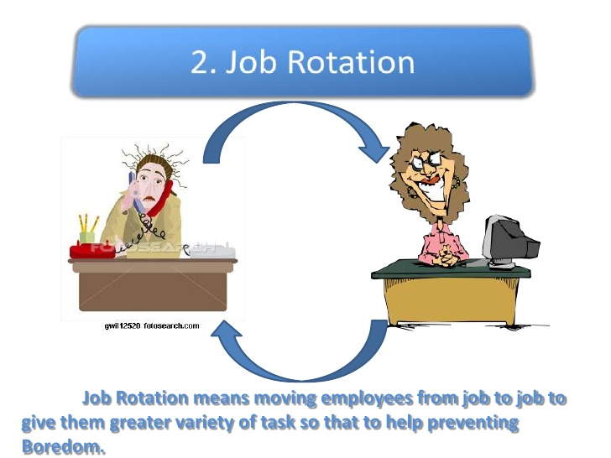
Job redesign
Redesign helps to give better control on jobs
Job enlargement and job enrichment play a major role in reducing stress

Slide 51

Reduction of role conflict and role ambiguity
Clear description of roles can reduce ambiguity

Slide 52

Greater employee participation
Participations creates the feeling of empowerment

Slide 53

Effective communication
Open communication reduces stress

Slide 54
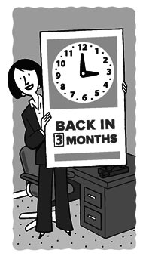
Sabbaticals
Employees may be given a break when needed
Employees come back refreshed, more creative and energetic

Slide 55

Wellness programs
Workshops on quit smoking, reduce alcohol consumption, healthy food habits and healthy life style can contribute to overall health of the employee

Slide 56
Summary
Organisational change
Forces for change
Stress
Causes of stress
Difference in stress perception
Effects of stress
Coping with stress

